Slide 1

Foundations of Data Visualization
CAP 5738 Data Visualization
Spring 2018
Dr. Sayeed S. Alam

Slide 2
Overview
Schedules
Textbook+ Web resources
Grading Policy
Assignments, Presentations
Visualization Process
Sensory vs Arbitrary Symbols
Gibson’s Affordance Theory

Slide 3
Schedules
CAP 5738 – U05
Data Visualization
Spring 2018
When: Monday and Wednesdays: 7:50 PM – 9:05 PM
Where: PG6-115

Slide 4
Schedules
Important Dates:
1/8 : Class Start
1/15 : Martin Luther King Holiday
3/12- 3/18: Spring Break
3/19 : Last day to drop a course with a DR grade
3/21 : Midterm
4/23-4/28: Finals Week

Slide 5

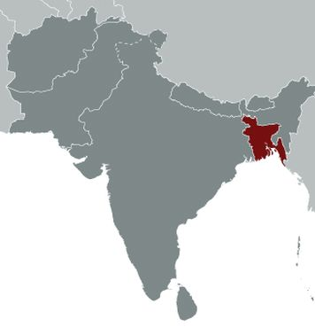
Your Professor!
Dr. Sayeed S. Alam
Email: salam011@cis.fiu.edu
Web: https://cis.fiu.edu/~salam011
Office Hours: TBA
Home Country: Bangladesh
Loves Chicken!!

Slide 6
Feedbacks
Send your positive/negative feedbacks (i.e. constructive criticisms).
To: salam011@cis.fiu.edu
Subject Line: [CAP5738-Spring2018-Feedback]
Let your Professor listen to you.

Slide 7
Textbook
“Information Visualization: Perception for Design”
Collin Ware (2nd/3rd Edition).
ISBN: 978-1558608191

Slide 8
Grading
Item | Percentile
Attendance | 10%
Assignments | 35%
Presentation | 15%
Midterm | 20%
Final Exam | 20%
Total: | 100%
Score | Grade
90-100 | A
80-89 | A-
75-79 | B+
70-74 | B
65-69 | B-
60-64 | C+
55-59 | C
50-54 | D
00-49 | F

Slide 9
Assignments
3-4 Assignments
Either programming or problem solving based
Programming problems will be regarding D3.JS

Slide 10
Paper Presentation
Paper presentation in a group of 2
Paper should be from renowned visualization/journals
Preferred conferences: InfoVis, EuroVis
Journals: TVCG, CGF
Please select your paper and group mate ASAP

Slide 11
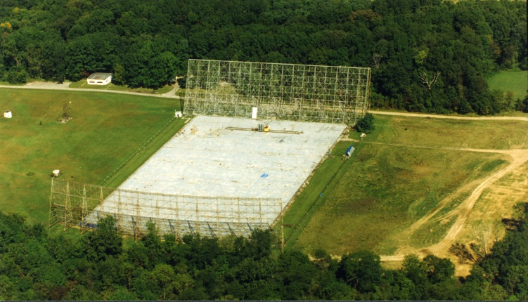
Search for Aliens!
Ohio State University
Big Ear!

Slide 12
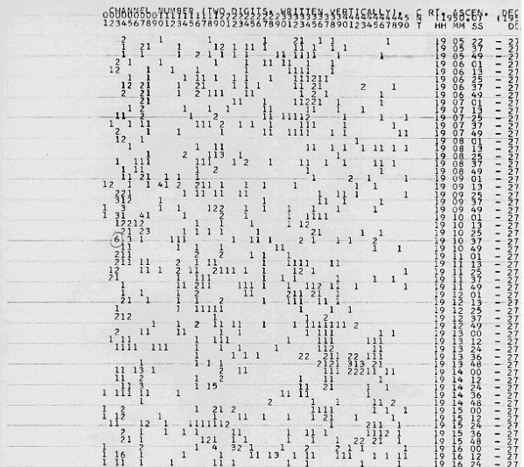
Big Ear Data
Number Scheme:
0=0
1= 1
…
9 = 9
10 = A
…
15 = F
16= G
…
35 = Z

Slide 13
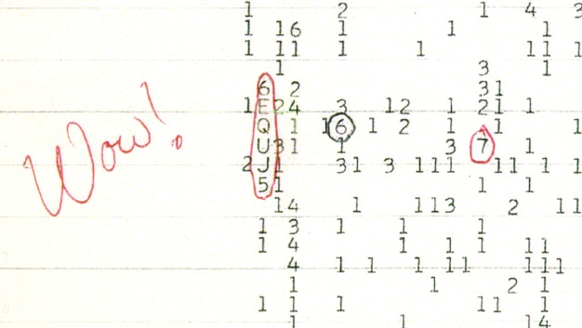
Alien Data!
Jerry R. Ehman discovered the WOW signal
On August 15, 1977
Source: Sagittarius Constellation

Slide 14
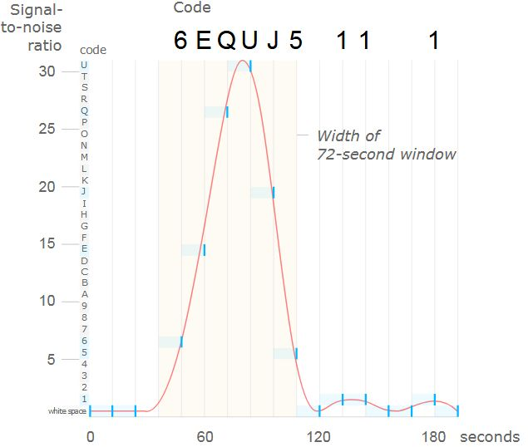
Why is it WOW?
Never such signal have been discovered!

Slide 15
Definition of Visualization
Old: constructing a visual image in the mind
New: A graphical representation of data or concepts

Slide 16
Advantages of Visualization
Visualization provides an ability to comprehend huge amounts of data.
Visualization allows the perception of emergent properties that were not anticipated
Visualization often enables problems with the data itself to become immediately apparent. A visualization commonly reveals things not only about the data itself, but about the way it is collected.
Visualization facilitates understanding of both large-scale and small-scale features of the data.
Visualization facilitates hypothesis formation.

Slide 17
Visualization Process

Slide 18
Visualization Stages
The collection and storage of data itself
The preprocessing designed to transform the data into something we can understand
The display hardware and the graphics algorithms that produce an image on the screen
The human perceptual and cognitive system (the perceiver)

Slide 19
Semiotics of Graphics
Semiotics: The study of symbols and how they convey meaning.

Slide 20
Arbitrary Symbols

Slide 21
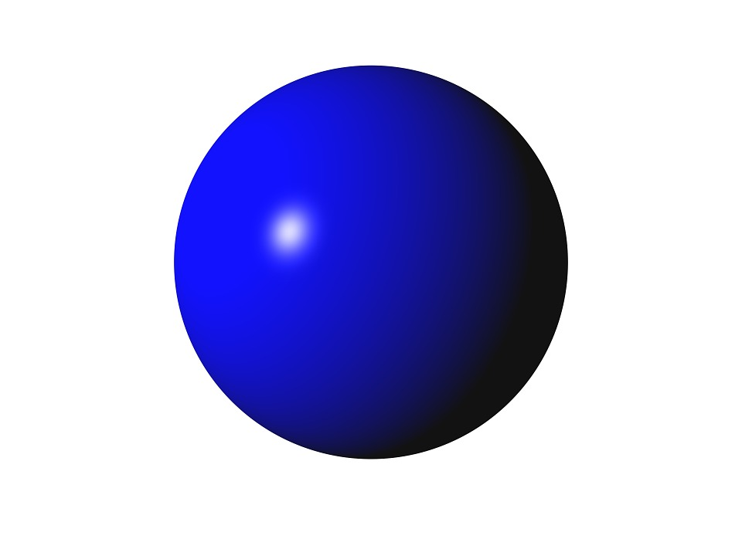
Properties of Sensory Symbols
Understanding without training.
Circle or Sphere?

Slide 22
Properties of Sensory Symbols
Understanding without training.
Resistance to instructional bias.
Which line is longer?

Slide 23
Properties of Sensory Symbols
Understanding without training.
Resistance to instructional bias.
Sensory immediacy.
How many segments?

Slide 24

Properties of Sensory Symbols
Understanding without training.
Resistance to instructional bias.
Sensory immediacy.
Cross-cultural validity
Does it mean good or bad?

Slide 25
Properties of Arbitrary Symbols/Codes
Hard to learn: Chinese alphabet
Easy to forget.
Embedded in culture and application.
New
Delete
Death
Goodluck

Slide 26
Properties of Arbitrary Symbols/Codes
Hard to learn: Chinese alphabet
Easy to forget
Embedded in culture and application.
Formally Powerful
Capable of rapid changes.

Slide 27
Gibson’s Affordance Theory
Gibson, 1979
We perceive in order to operate on the environment. Perception is designed for action.
The perceivable possibilities are for action affordances; we perceive these properties of the environment in a direct and immediate way.
Pre-Gibson: Bottom-up approach: We should first understand how single points of light were perceived, and then we could work on understanding how pairs of lights interacted and gradually build up to understanding the vibrant, dynamic visual world in which we live.

Slide 28
Gibson’s Affordance Theory
Wanna Climb up?

Slide 29
Problems With Gibson’s Affordance Theory
Visualization of data through computer graphics is very indirect. In some cases, the source of the data may be microscopic or otherwise invisible.
No clear physical affordances in any graphical user interface.
Complete rejection of Visual Mechanism.
Button
Is it necessary to print?

Slide 30
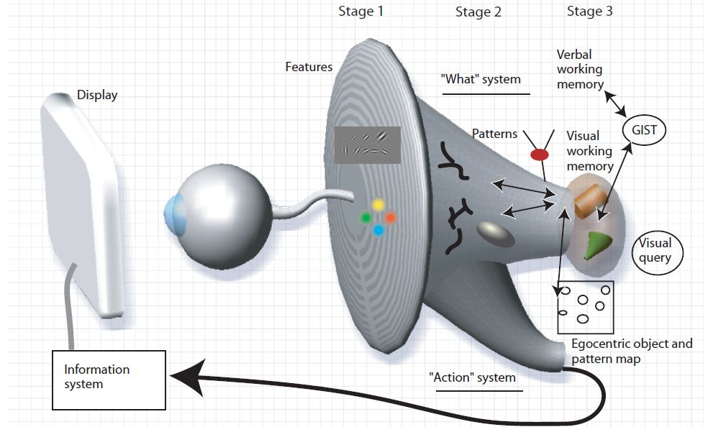
A Model of Perceptual Processing

Slide 31
Stage-1: Parallel Processing to Extract Low-Level Properties of the Visual Scene
Rapid parallel processing
Extraction of features, orientation, color, texture, and movement patterns
Transitory nature of information, which is briefly held in an iconic store
Bottom-up, data-driven model of processing

Slide 32
Stage 2: Pattern Perception
Slow serial processing
Involvement of both working memory and long-term memory
More emphasis on arbitrary aspects of symbols
In a state of flux, a combination of bottom-up feature processing and top-down attentional mechanisms
Different pathways for object recognition and visually guided motion

Slide 33
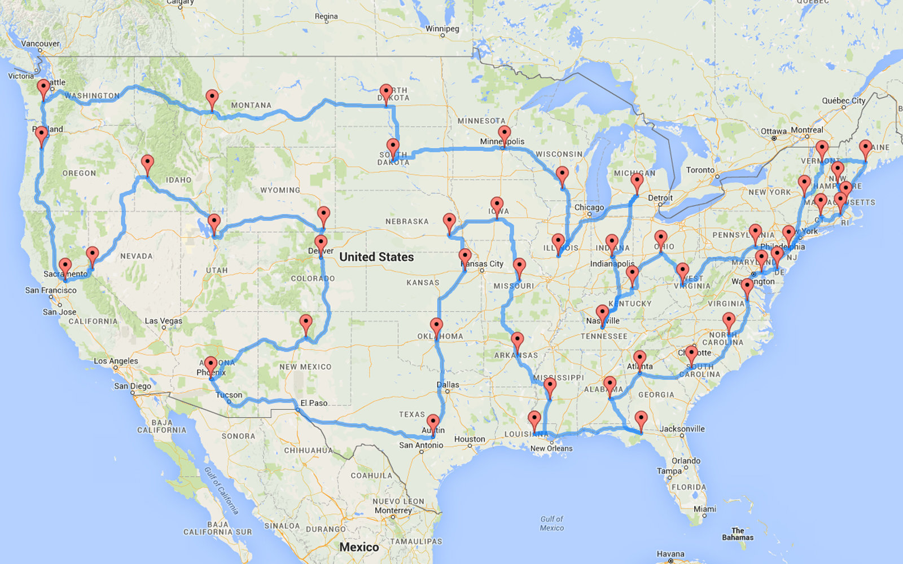
Stage 3: Sequential Goal-Directed Processing
At the highest level of perception are the objects held in visual working memory by the demands of active attention.
In order to use an external visualization, we construct a sequence of visual queries that are answered through visual search strategies.

Slide 34
Thank You

